Slide 1
Tithes & Offerings

Slide 2
Options for submitting Tithes & Offerings
Send a check to church: Shawnee Mission Baptist Temple, PO Box 860823 Shawnee, KS 66286.
Contact your bank to have them send check to: Shawnee Mission Baptist Temple, PO Box 860823 Shawnee, KS 66286. Designate in memo section how you would like the funds to be used, General, Faith Promise or Vision!
Drop off checks or cash at Youth Director’s house, 21503 Midland Dr. Shawnee, KS
Visit church website: www.smbt.org and utilize the online giving option.

Slide 3
Online Giving – www.smbt.org
Select Online giving button from the home page!

Slide 4
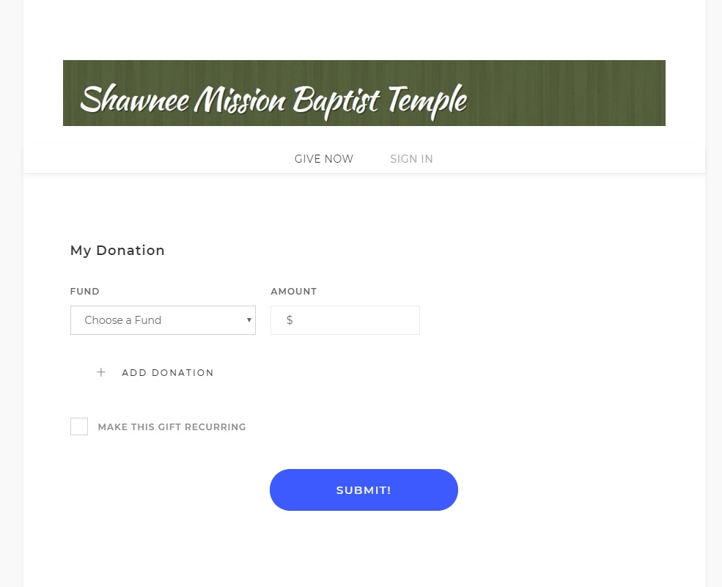
Select Give Now if you do not want to set up an account.
Select Sign In if you have an account or if you would like to register for and account.

Slide 5
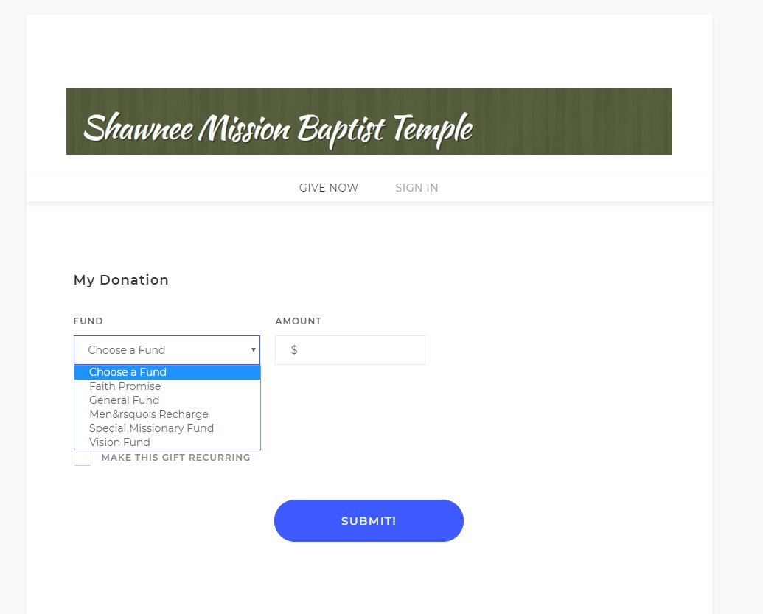
After Give Now is selected, you will need to select the Fund that you want the money to be given to: General Fund, Faith Promise or Vision Fund.
To select more than one fund you will have to complete a separate transaction for each fund.
Example: to give tithe, select General Fund and input the amount and then submit.
To give for faith promise, select Faith Promise input the amount and then submit.

Slide 6
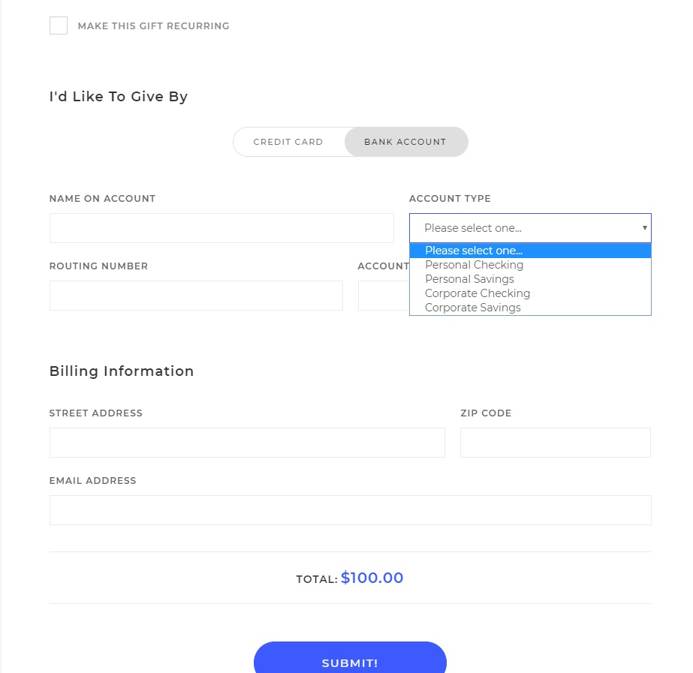
Complete “I’d Like to Give By”:
Select either Bank Account or Credit Card tabs, Preferred method would to be to select Bank Account as this is less expense to church.
Select the account type drop down arrow for which account you want your giving to come out of for your records.
Complete the Billing Information and then select submit button to complete your transaction.

Slide 7
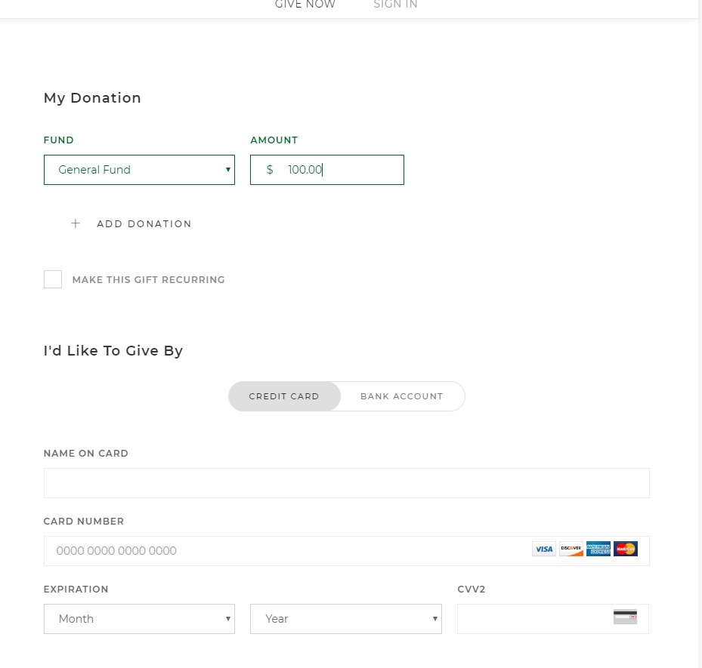
If you give via a credit card, complete all the normal debit/credit card information requested and submit to complete transaction.
Remember if giving to General and Faith Promise you will need to complete two transactions!

Slide 8
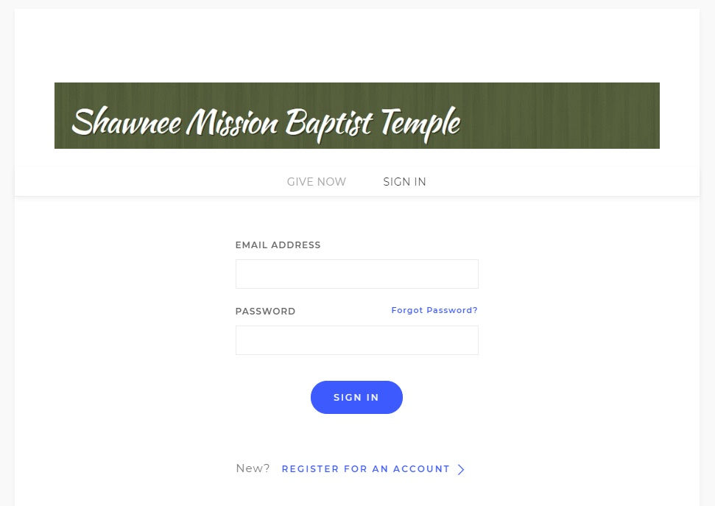
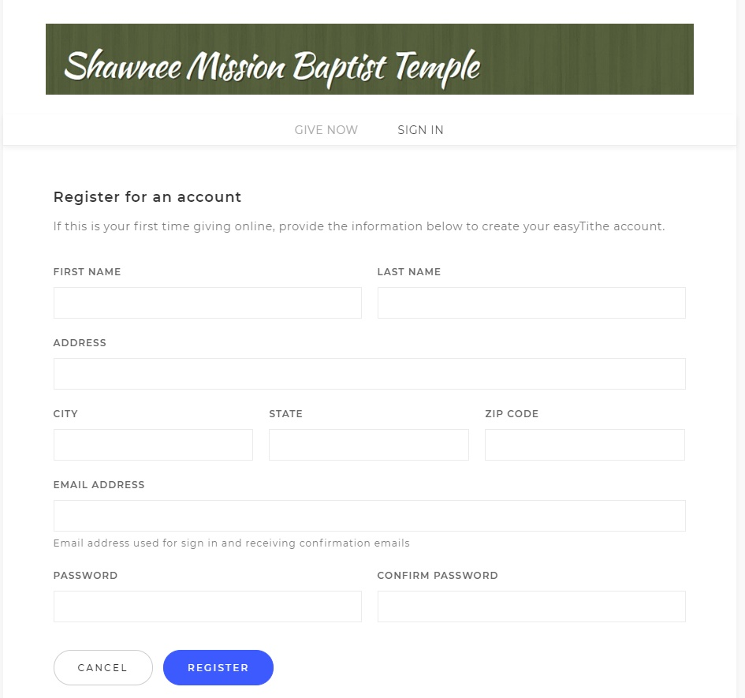
To set up an account, select “Sign In” and then register for an account.
Complete the information for your account including your own password and select Register button to complete registration!

Slide 9
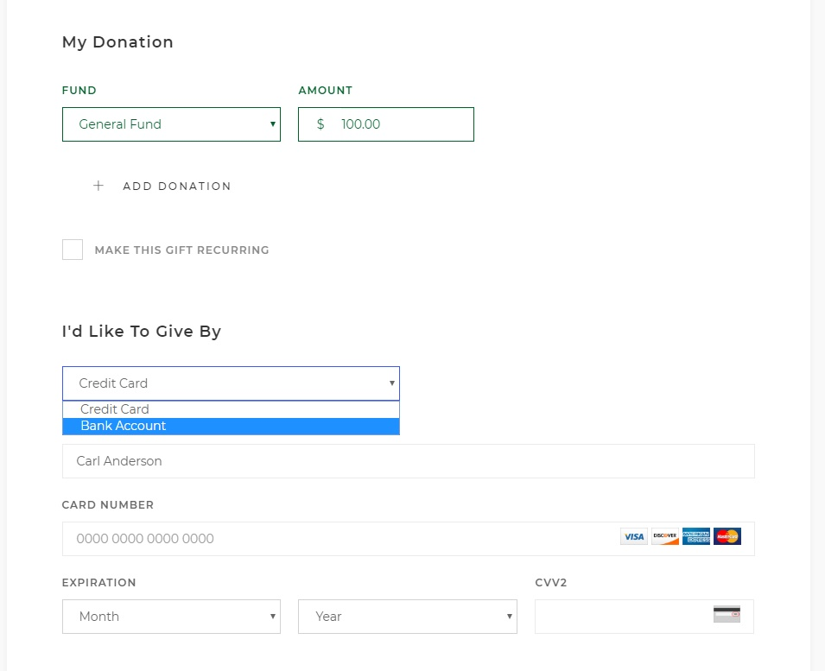
Complete the online giving by selecting the Bank account or Credit Card option. Selecting the Bank account option will have less expense for the church and more money for God’s work.
Complete the bank account information or credit card information and then select Submit button to complete transaction.

Slide 10
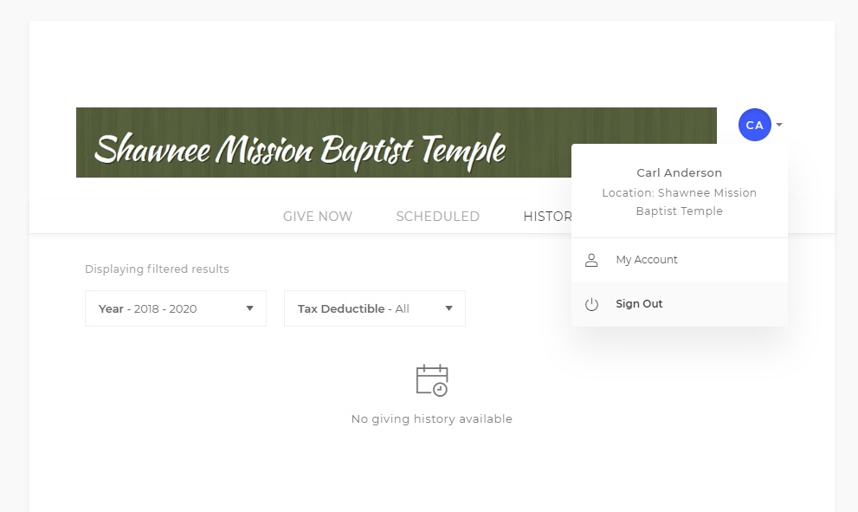
Very Important that when you have completed all your transactions that you sign out of your account!

Slide 11
Thank you for supporting God’s Work!

